Slide 1

What affects restaurant reviews?
Lina Arustamyan
Mariam Poghosyan
Aleksandr Hovsepyan

Slide 2




Tips for trips
Decide which country you want to visit
Search in Internet information you need
Read dozens of reviews

Slide 3

Restaurants and traditional cuisine
Are an important factor of a country's culture and national heritage, and while deciding which country to visit people usually go to TripAdvisor and have a look at the list of restaurants and cafes in a specific country and their reviews.

Slide 4



Literature review
Service quality
Taste of food
Value for money
Atmosphere of the restaurant

Slide 5
DATA AND METODOLOGY
For scraping this website, we used the following techniques
S
Scrapy framework
R
Regular expressions
C
CSS approach
Y
Yandex Maps API

Slide 6





Variables
Number of reviews
Price range
Cuisine type
N
Restaurant ratings
Distance
Special diet availability

Slide 7
Results
44%
47%
Armenian cuisine
Vegetarian menu

Slide 8
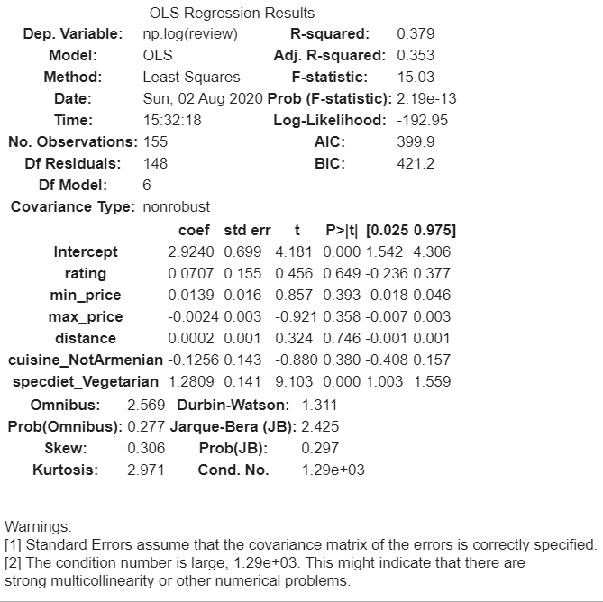
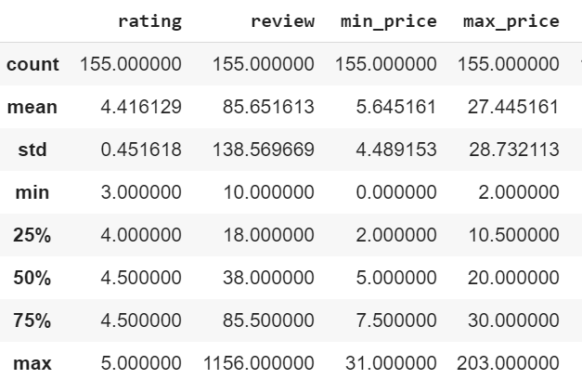
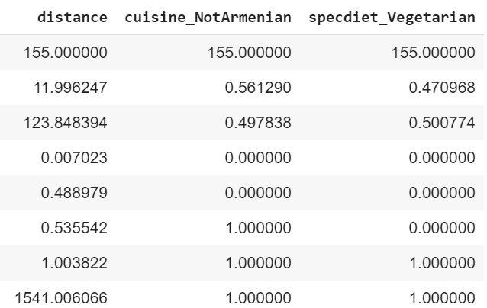
Results

Slide 9
CONCLUSION
Taking into account the fact that other researchers have done similar studies and got significant results, we can conclude that we did not get significant results because of the specific nature of our data. However, this may be a starting point for future research and other interesting variables can be added into the model.

Slide 10

Thank you

